Slide 1
Cloud Data Engineering
Lecture 4

Slide 2
MapReduce Model and Techniques

Slide 3
Introduction to Big Data Solutions – Traditional Approach
An enterprise will have a computer to store and process big data. For storage purpose, the programmers will take the help of their choice of database vendors such as Oracle, IBM, etc. In this approach, the user interacts with the application, which in turn handles the part of data storage and analysis.
Centralized
System
Relational
DB
User
Ghemawat, S., Gobioff, H., & Leung, S. T. (2003, October). The Google file system. In Proceedings of the nineteenth ACM symposium on Operating systems principles (pp. 29-43).

Slide 4
Traditional Approach - What is the limit?
This approach works fine with those applications that process less voluminous data that can be accommodated by standard database servers, or up to the limit of the processor that is processing the data.
For example, we have 10TB documents with average size of 20KB (total of 200TB). We want to build a model to count occurrences of words. Simple iterative loop will take ~1 month on simple computer.
What’s next?

Slide 5
Motivation
Process lots of data
Google processed about 24 petabytes of data per day in 2009.
A single machine cannot serve all the data
You need a distributed system to store and process in parallel
Parallel programming?
Threading is hard!
How do you facilitate communication between nodes?
How do you scale to more machines?
How do you handle machine failures?

Slide 6
Google’s Solution
Google solved this problem using an algorithm called MapReduce. This algorithm divides the task into small parts and assigns them to many computers, and collects the results from them which when integrated, form the result dataset.
Centralized
System
User

Slide 7
Google’s Solution
Problem: Can’t use a single computer to process the data (take too long to process data).
Solution: Use a group of interconnected computers (processor, and memory independent).
Problem: Conventional algorithms are not designed around memory independence.
Solution: MapReduce
Definition. MapReduce is a programming paradigm model of using parallel, distributed algorithms to process or generate data sets.

Slide 8
How Is It Work?
The MapReduce algorithm contains two important tasks:
The Map task takes a set of data and converts it into another set of data, where individual elements are broken down into tuples (key-value pairs).
The Reduce task takes the output from the Map as an input and combines those data tuples (key-value pairs) into a smaller set of tuples.
The reduce task is always performed after the map job.

Slide 9
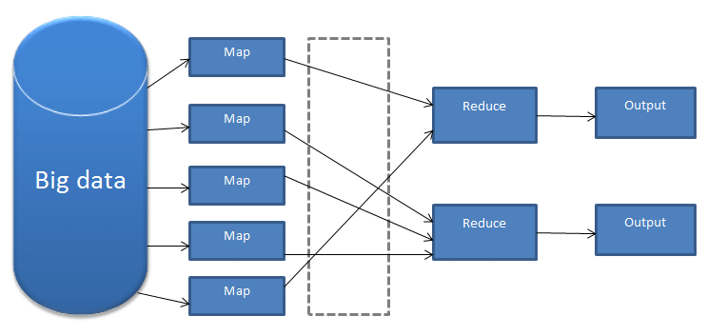
How Is It Work?
The reduce task is always performed after the map job.

Slide 10
MapReduce workflow
Input Data
Output Data
Worker
write
Output
File 0
local
write
Worker
Split 0
read
Split 1
Worker
Split 2
Output
File 1
Worker
Worker
remote
read,
sort
Map
extract something you care about from each record
Reduce aggregate, summarize, filter, or transform

Slide 11
MapReduce Architecture
Input Phase − Here we have a Record Reader that translates each record in an input file and sends the parsed data to the mapper in the form of key-value pairs.
Map − Map is a user-defined function, which takes a series of key-value pairs and processes each one of them to generate zero or more key-value pairs.
Input
Input
Input
Input
Input
Map
Map
Map
Map
Map

Slide 12
MapReduce Architecture
Intermediate Keys − They key-value pairs generated by the mapper are known as intermediate keys.
Combiner (Optional) − A combiner is a type of local Reducer that groups similar data from the map phase into identifiable sets.
Input
Input
Input
Input
Input
Map
Map
Map
Map
Map
Keys
Keys
Keys
Keys
Keys
Combiner

Slide 13
MapReduce Architecture
Shuffle and Sort − The Reducer task starts with the Shuffle and Sort step. It downloads the grouped key-value pairs onto the local machine, where the Reducer is running.
The individual key-value pairs are sorted by key into a larger data list. The data list groups the equivalent keys together so that their values can be iterated easily in the Reducer task.
Input
Input
Input
Input
Input
Map
Map
Map
Map
Map
Keys
Keys
Keys
Keys
Keys
Combiner
S/S
S/S
S/S
S/S

Slide 14
MapReduce Architecture
Reducer − The Reducer takes the grouped key-value paired data as input and runs a Reducer function on each one of them. Here, the data can be aggregated, filtered, and combined in a number of ways, and it requires a wide range of processing. Once the execution is over, it gives zero or more key-value pairs to the final step.
Input
Input
Input
Input
Input
Map
Map
Map
Map
Map
Keys
Keys
Keys
Keys
Keys
Combiner
S/S
S/S
S/S
S/S
Reduce
Reduce
Reduce
Reduce

Slide 15
MapReduce Architecture
Output Phase − In the output phase, we have an output formatter that translates the final key-value pairs from the Reducer function and writes them onto a file using a record writer.
Input
Input
Input
Input
Input
Map
Map
Map
Map
Map
Keys
Keys
Keys
Keys
Keys
Combiner
S/S
S/S
S/S
S/S
Reduce
Reduce
Reduce
Reduce
Output

Slide 16
Example
Input
Split
Map
Shuffle & Sort
Reduce
A B R
C C R
A C B

Slide 17
Example
Input
Split
Map
Shuffle & Sort
Reduce
A B R
A B R
C C R
A C B
C C R
A C B

Slide 18
Example
Input
Split
Map
Shuffle & Sort
Reduce
A B R
A, 1
B, 1
R, 1
A B R
C C R
A C B
C C R
C, 1
C, 1
R, 1
A C B
A, 1
C, 1
B, 1

Slide 19
Example
Input
Split
Map
Shuffle & Sort
Reduce
A B R
A, 1
B, 1
R, 1
A, 1
A, 1
A B R
C C R
A C B
B, 1
B, 1
C C R
C, 1
C, 1
R, 1
C, 1
C, 1
C, 1
A C B
A, 1
C, 1
B, 1
R, 1
R, 1

Slide 20
Example
Input
Split
Map
Shuffle & Sort
Reduce
A B R
A, 1
B, 1
R, 1
A, 1
A, 1
A, 2
B, 2
C, 3
R, 2
A B R
C C R
A C B
B, 1
B, 1
C C R
C, 1
C, 1
R, 1
C, 1
C, 1
C, 1
A C B
A, 1
C, 1
B, 1
R, 1
R, 1

Slide 21
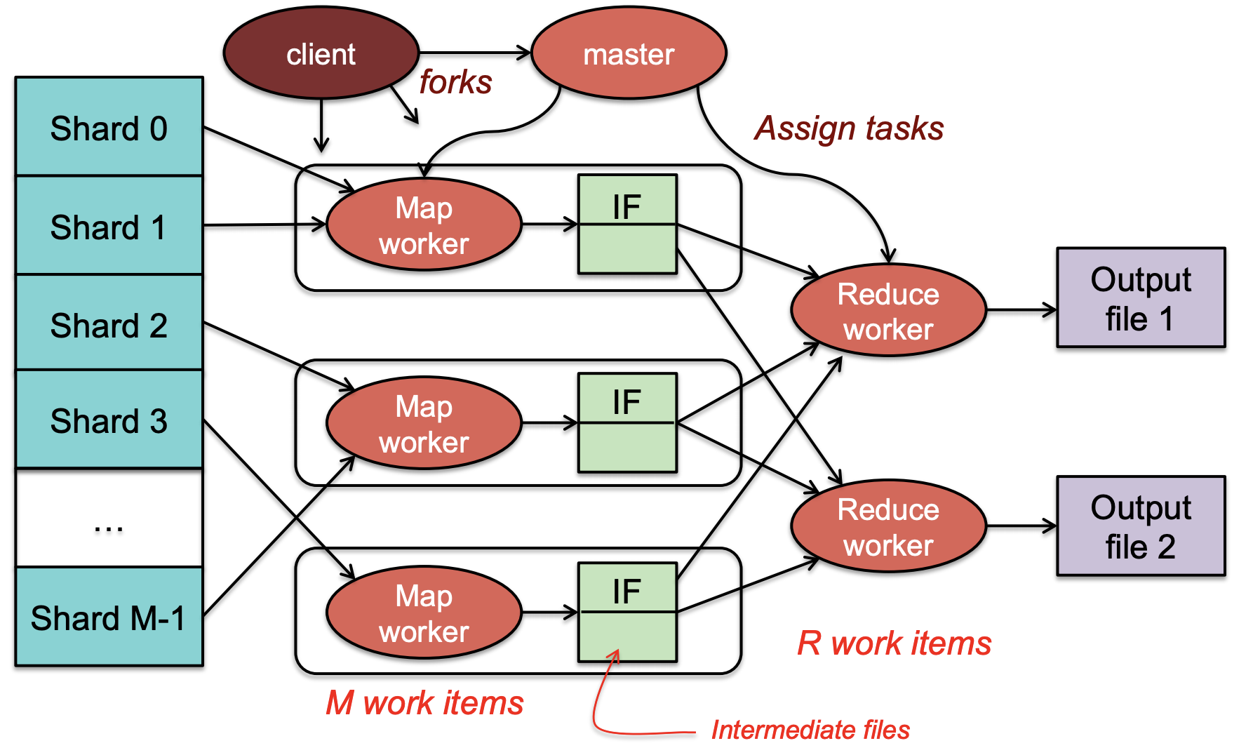
The Power of Map-Reduce

Slide 22
Why is Map-Reduce Popular?
Distributed computation before MapReduce
Divide the workload among multiple machines
Distribute data and program to other machines
Distributed computation after MapReduce
Write Map function
Write Reduce function
Developers’ tasks made easy
Divide the problem into sub-problems (divide and conquer paradigm)

Slide 23
Mean Example
Input
Split
Map
Reduce
96
54
12
60
29
52

Slide 24
Mean Example
Input
Split
Map
Reduce
96
54
96
54
12
60
29
52
12
60
29
52

Slide 25
Mean Example
Input
Split
Map
Reduce
96
54
96,1
54,1
96
54
12
60
29
52
12
60
12,1
60,1
29
52
29,1
52,1

Slide 26
Mean Example
Input
Split
Map
Reduce
96
54
96,1
54,1
150,2
96
54
12
60
29
52
12
60
12,1
60,1
72,2
29
52
29,1
52,1
81,2

Slide 27
Mean Example
Input
Split
Map
Reduce
96
54
96,1
54,1
150,2
96
54
12
60
29
52
12,1
60,1
72,2
303,6
12
60
29
52
29,1
52,1
81,2

Slide 28
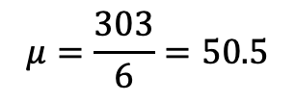
Mean Example
Input
Split
Map
Reduce
96
54
96,1
54,1
150,2
96
54
12
60
29
52
12,1
60,1
72,2
303,6
12
60
$$μ=\frac{303}{6}=50.5$$
29
52
29,1
52,1
81,2

Slide 29
Mappers and Reducers
Need to handle more data? Just add more Mappers/Reducers!
No need to handle multithreaded code ☺
Mappers and Reducers are typically single threaded and deterministic
Determinism allows for restarting of failed jobs
Mappers/Reducers run entirely independent of each other
In Hadoop, they run in separate JVMs

